Slide 1
Day 6

Slide 2
Intel VTune

Slide 3
Hotspot analysis using VTune
Hotspot analysis in Intel VTune Profiler is a performance profiling technique that helps identify the sections of code in an application where most of the CPU time is spent
These sections, known as "hotspots," are the primary candidates for optimization because improving their performance can lead to significant overall improvements in the application

Slide 4
Hotspots
Hotspots are parts of the code, typically functions or specific lines, that consume a large proportion of the total execution time
By focusing optimization efforts on these areas, developers can achieve the most substantial performance gains
VTune provides detailed insights into where the application spends most of its time, enabling developers to focus their optimization efforts on the most impactful areas.

Slide 5
Why hotspots analysis is Important
Resource Utilization: Identifying and optimizing hotspots helps in better utilization of CPU resources
Performance Bottlenecks: It highlights the bottlenecks that slow down the application
Efficiency: Enhances the efficiency of the application by reducing execution time and improving responsiveness

Slide 6
How hotspots analysis works in VTune
VTune collects performance data while the application runs. This involves monitoring CPU activity, memory accesses, and thread behavior to gather detailed information about where time is being spent

Slide 7
How hotspots analysis works in VTune
Sampling Mode: VTune periodically interrupts the application to collect the current state of the CPU, including the instruction pointer and call stack. This method has minimal impact on performance and provides statistical insights.
Tracing Mode: VTune instruments the application to capture detailed events. This mode can provide more precise data but with higher overhead.

Slide 8
How hotspots analysis works in VTune
VTune analyzes the collected data to identify functions or code regions that consume the most CPU time
The profiler then ranks these hotspots based on their CPU usage, making it easier to prioritize optimization efforts

Slide 9
Loading module for running VTune
Loading module
module avail | grep vtune
module load oneapi/vtune/2021.5.0

Slide 10
Installing Vtune using Spack
spack list | grep vtune
spack find intel-oneapi-vtune
spack info intel-oneapi-vtune
spack spec -I intel-oneapi-vtune
spack install -v -j40 intel-oneapi-vtune
spack load intel-oneapi-vtune

Slide 11
Running matrix multiplication with VTune
Running application with VTune (through command line)
vtune --collect=hotspot --result-dir=./report -- ./mmult_serial
cd report
vtune-gui report.vtune

Slide 12
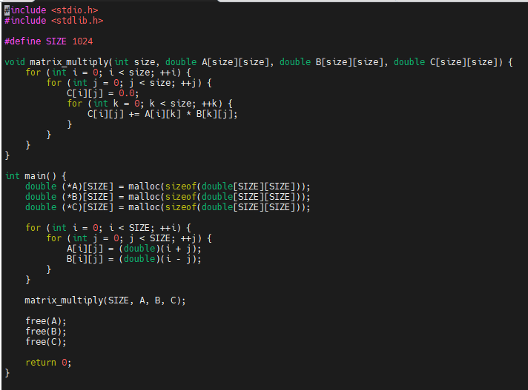
Running matrix multiplication with VTune

Slide 13
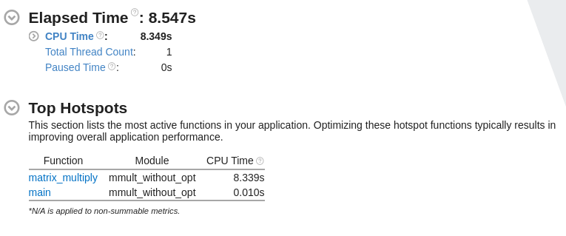
Running matrix multiplication with VTune

Slide 14
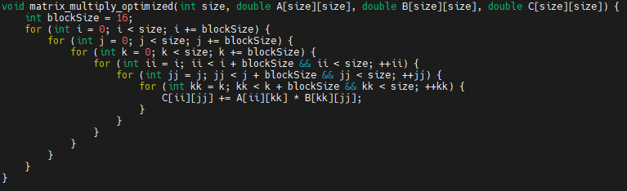
Running matrix multiplication with VTune

Slide 15
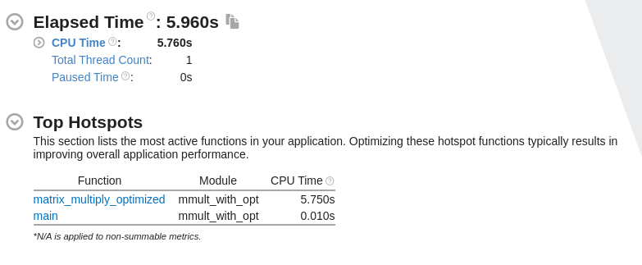
Running matrix multiplication with VTune

Slide 16
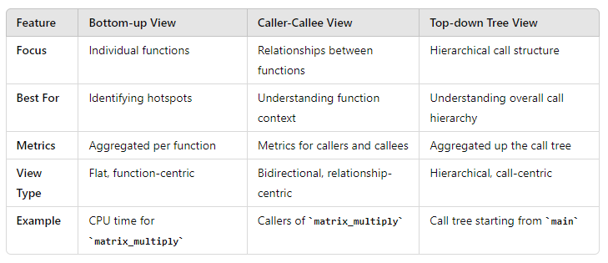
Running matrix multiplication with VTune

